Slide 1


VortexC Equine

Slide 2
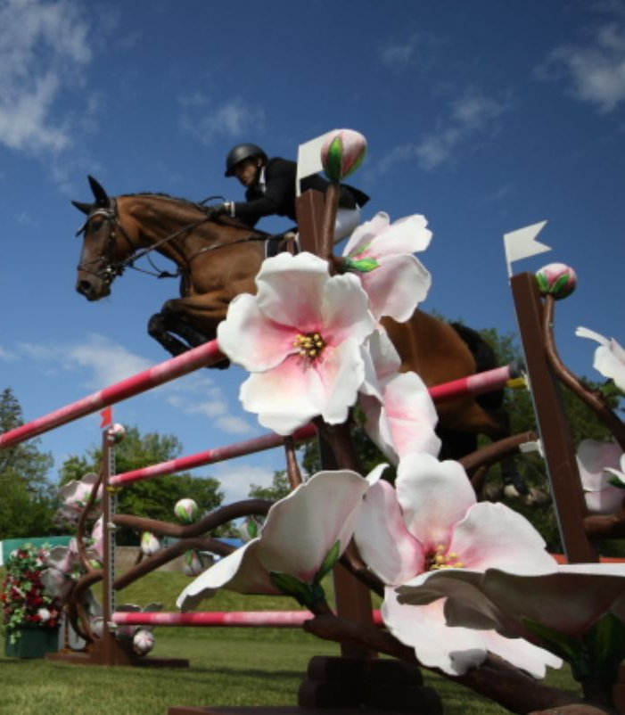
VortexC Equine Advantage
DONNER SIRE: THUNDER VD ZUUTHOEVE DAM: BURMESE SIRE OF DAM: HEARTBREAKER AGE: 14, SEX: GELDING G
Increase in Horse Value:
Proprietary Industry Disrupting Technologies
Results
Currently competing at the highest levels

Slide 3
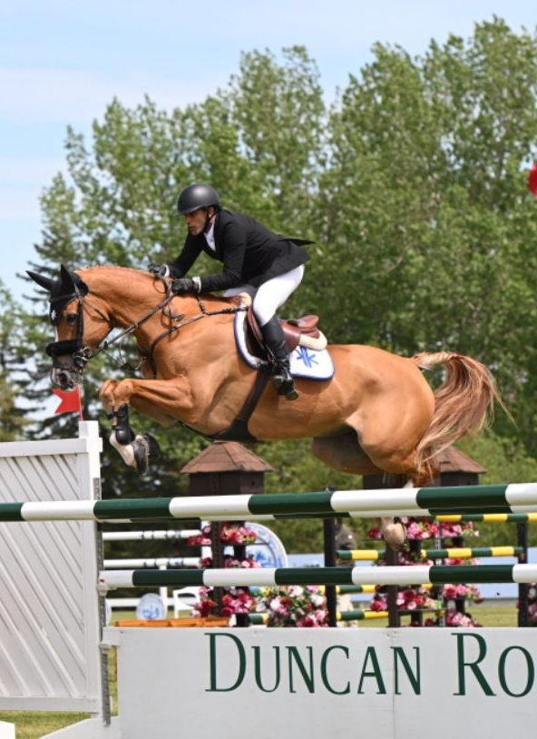
VortexC Equine Advantage
LEGALAND SANDRO​ SIRE: SANDRO BOY​ DAM: DRUMILLER DIGITAL​ SIRE OF DAM: CLINTON​ AGE: 10, SEX: GELDING​
Real Time Energetic Quantum Diagnostics
Mitochondrial Biogenesis
Global Real Time Frequency Controlled Therapies
Proprietary Water System

Slide 4
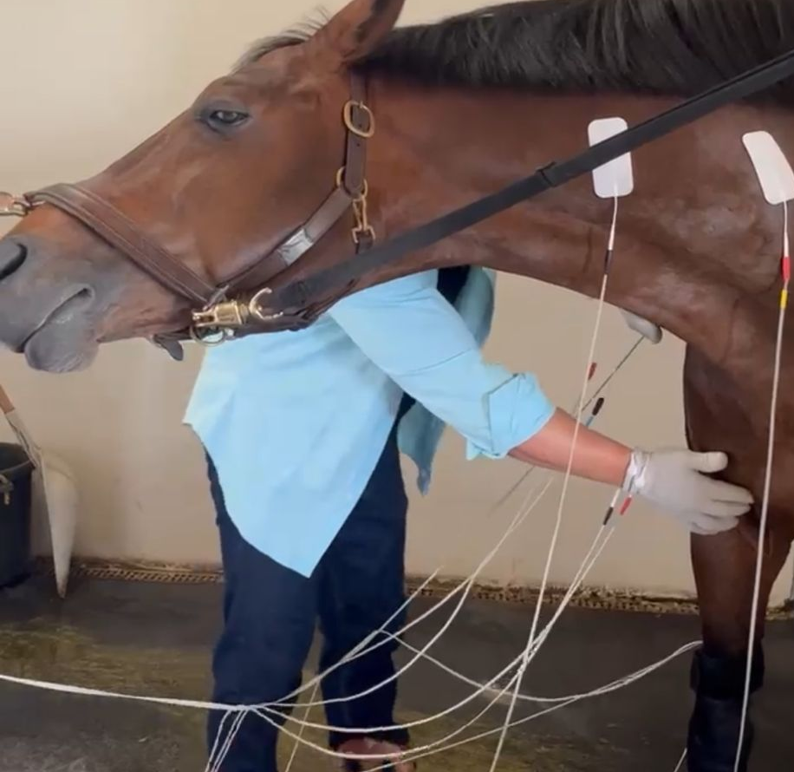
VortexC Equine Advantage
Advanced Horse Care
Environmental Enhancement/Transmutations
Mitigate Mental, Physical, Emotional and Spiritual Threats
QOURTOIS​ SIRE: NABAB DE REVE​ DAM: UPHDIM VAN DE PUITVOET​ SIRE OF DAM: HEARTBREAKER​ AGE: 08, SEX: GELDING​

Slide 5

VortexC Equine Investment Opportunity
Proprietary VortexC Program
Exclusive Access
Innovation and Research
Energetic Approach

Slide 6

VortexC Equine Investment Opportunity
Uncorrelated Returns
Diversification Benefits
Economic Resilience
Unique Market Dynamics

Slide 7

VortexC Equine Investment Opportunity
Tax Efficiencies & Cash Management
Advanced Energetic Modalities
Depreciation Benefits
Expense Deductions
Capital Gains Optimization

Slide 8

VortexC Equine Investment Opportunity
Portfolio Diversification
Alternative Asset Class
Stable Returns
Full Value Insurance Coverage
15% Target Return per Horse

Slide 9

VortexC Equine Investment Opportunity
Global Audience & Demand
Growing Popularity
Enhanced Exposure: World Cup, Pan-Am Games, Summer Olympics, WEF, MLSJ and more
International Competition
Huge Gains
Energetic Industry Disruption

Slide 10
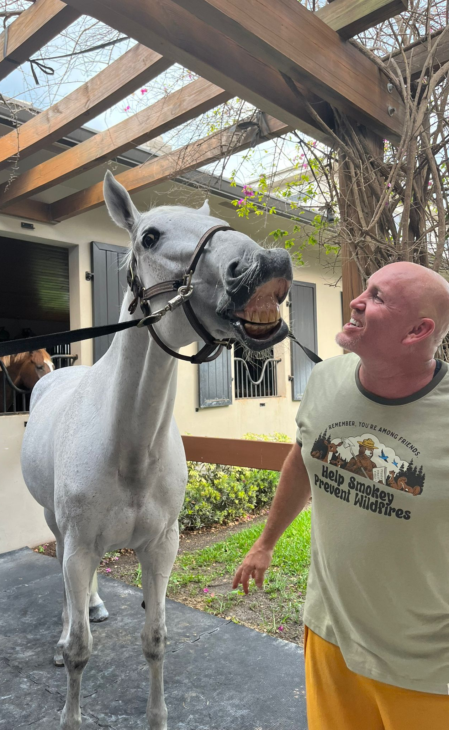
VortexC Equine Process
EVABELLIE W SIRE: COLMAN DAM: ANNABELLIE AGE: 15, SEX: MARE
Source
Source High-Potential Horses
Implement
Implement VortexC Program
Showcase
Increase
Increase Value
Sell
Sell for Profit
Place Top 12 Consistently

Slide 11
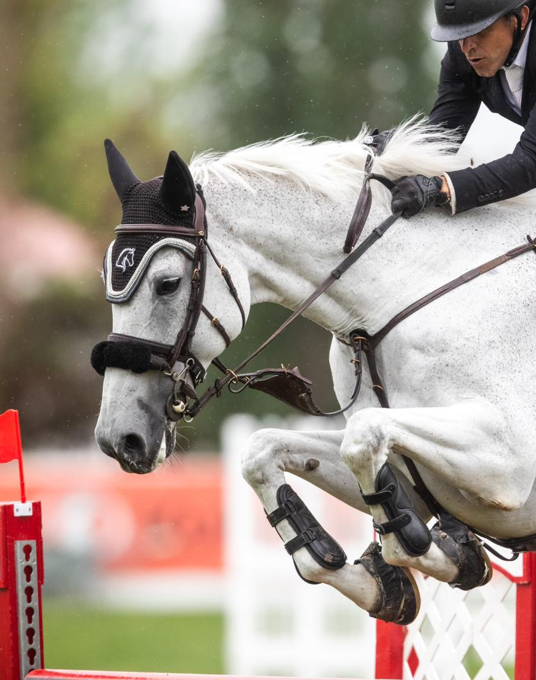
VortexC Program Highlights
VortexP Peptides
Exclusive + Proprietary
Energy Optimization
Real Time Data
EVABELLIE W SIRE: COLMAN DAM: ANNABELLIE AGE: 15, SEX: MARE

Slide 12
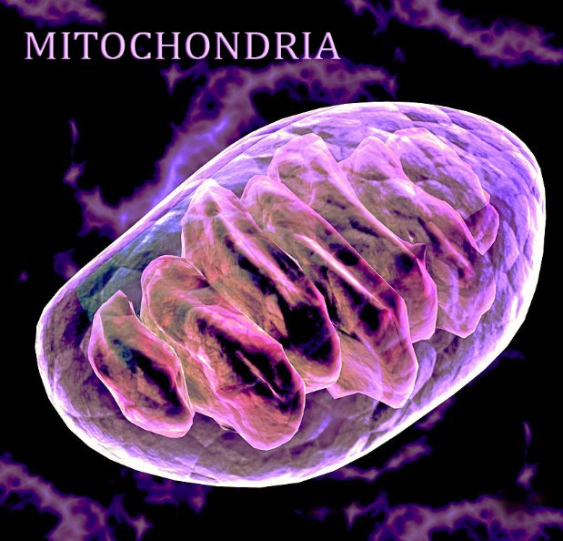
VortexC Program Highlights
Mitochondria Scoring System
Energy Optimization
Performance Readiness
Training Adjustments

Slide 13
The VortexC Impact (Health benefits)
Healing :
Scar Tissue Elimination:
Energetic
Tissue Remodeling
Rapid Recovery:
Mito Optimization
Daily Health Scans:
Real-Time Data
Preventive Care:
Vaccine Mitigation
Nutritional Support:
Customized Diet Plans
Supplement Programs
We work above the speed of speed where anything is possible in an instant

Slide 14
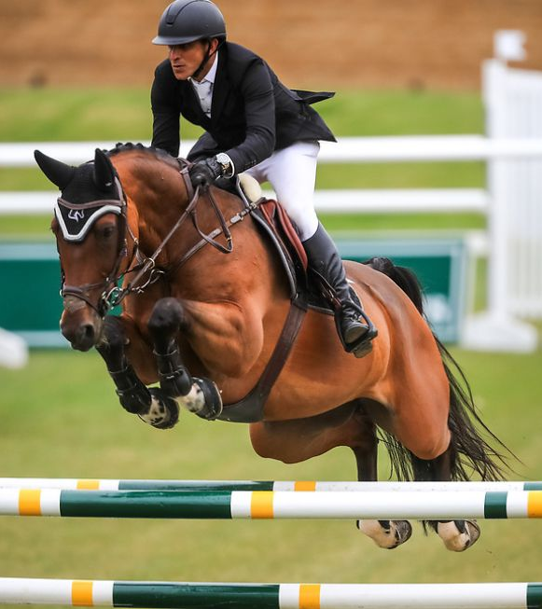
VortexC Team - 6* FEI
DONNER SIRE: THUNDER VD ZUUTHOEVE DAM: BURMESE SIRE OF DAM: HEARTBREAKER AGE: 14, SEX: GELDING
DONNER
Q
THOMAS
LUI
NYLES
VALUES OF 1.60m 6* FEI SHOWJUMPERS CAN EXCEED $20M /HORSE

Slide 15
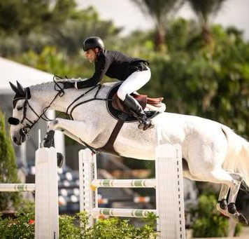
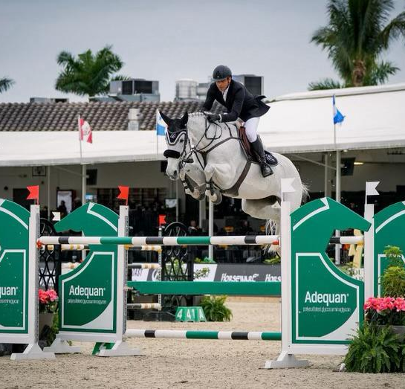
EVABELLIE W SIRE: COLMAN DAM: ANNABELLIE AGE: 15, SEX: MARE
BACKGROUND
MULTIPLE TENDON TEAR
CURRENT 1.45M TOP PLACEMENT
RECOVERY
NO SCAR TISSUE
3*/4* FEI EVENTS
CURRENT STATUS
LONGEST AND FIRST DATASTREAM
LONG TERM TREATMENT PROGRAMS
MASSIVE IMPROVEMENT IN ENERGETICS

Slide 16
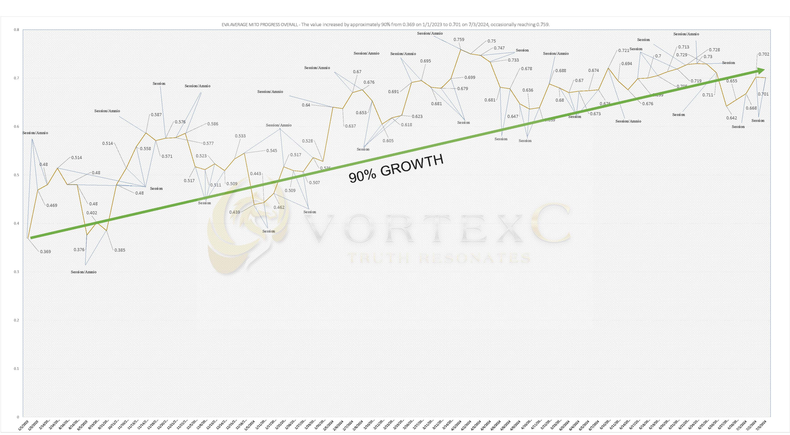

Slide 17
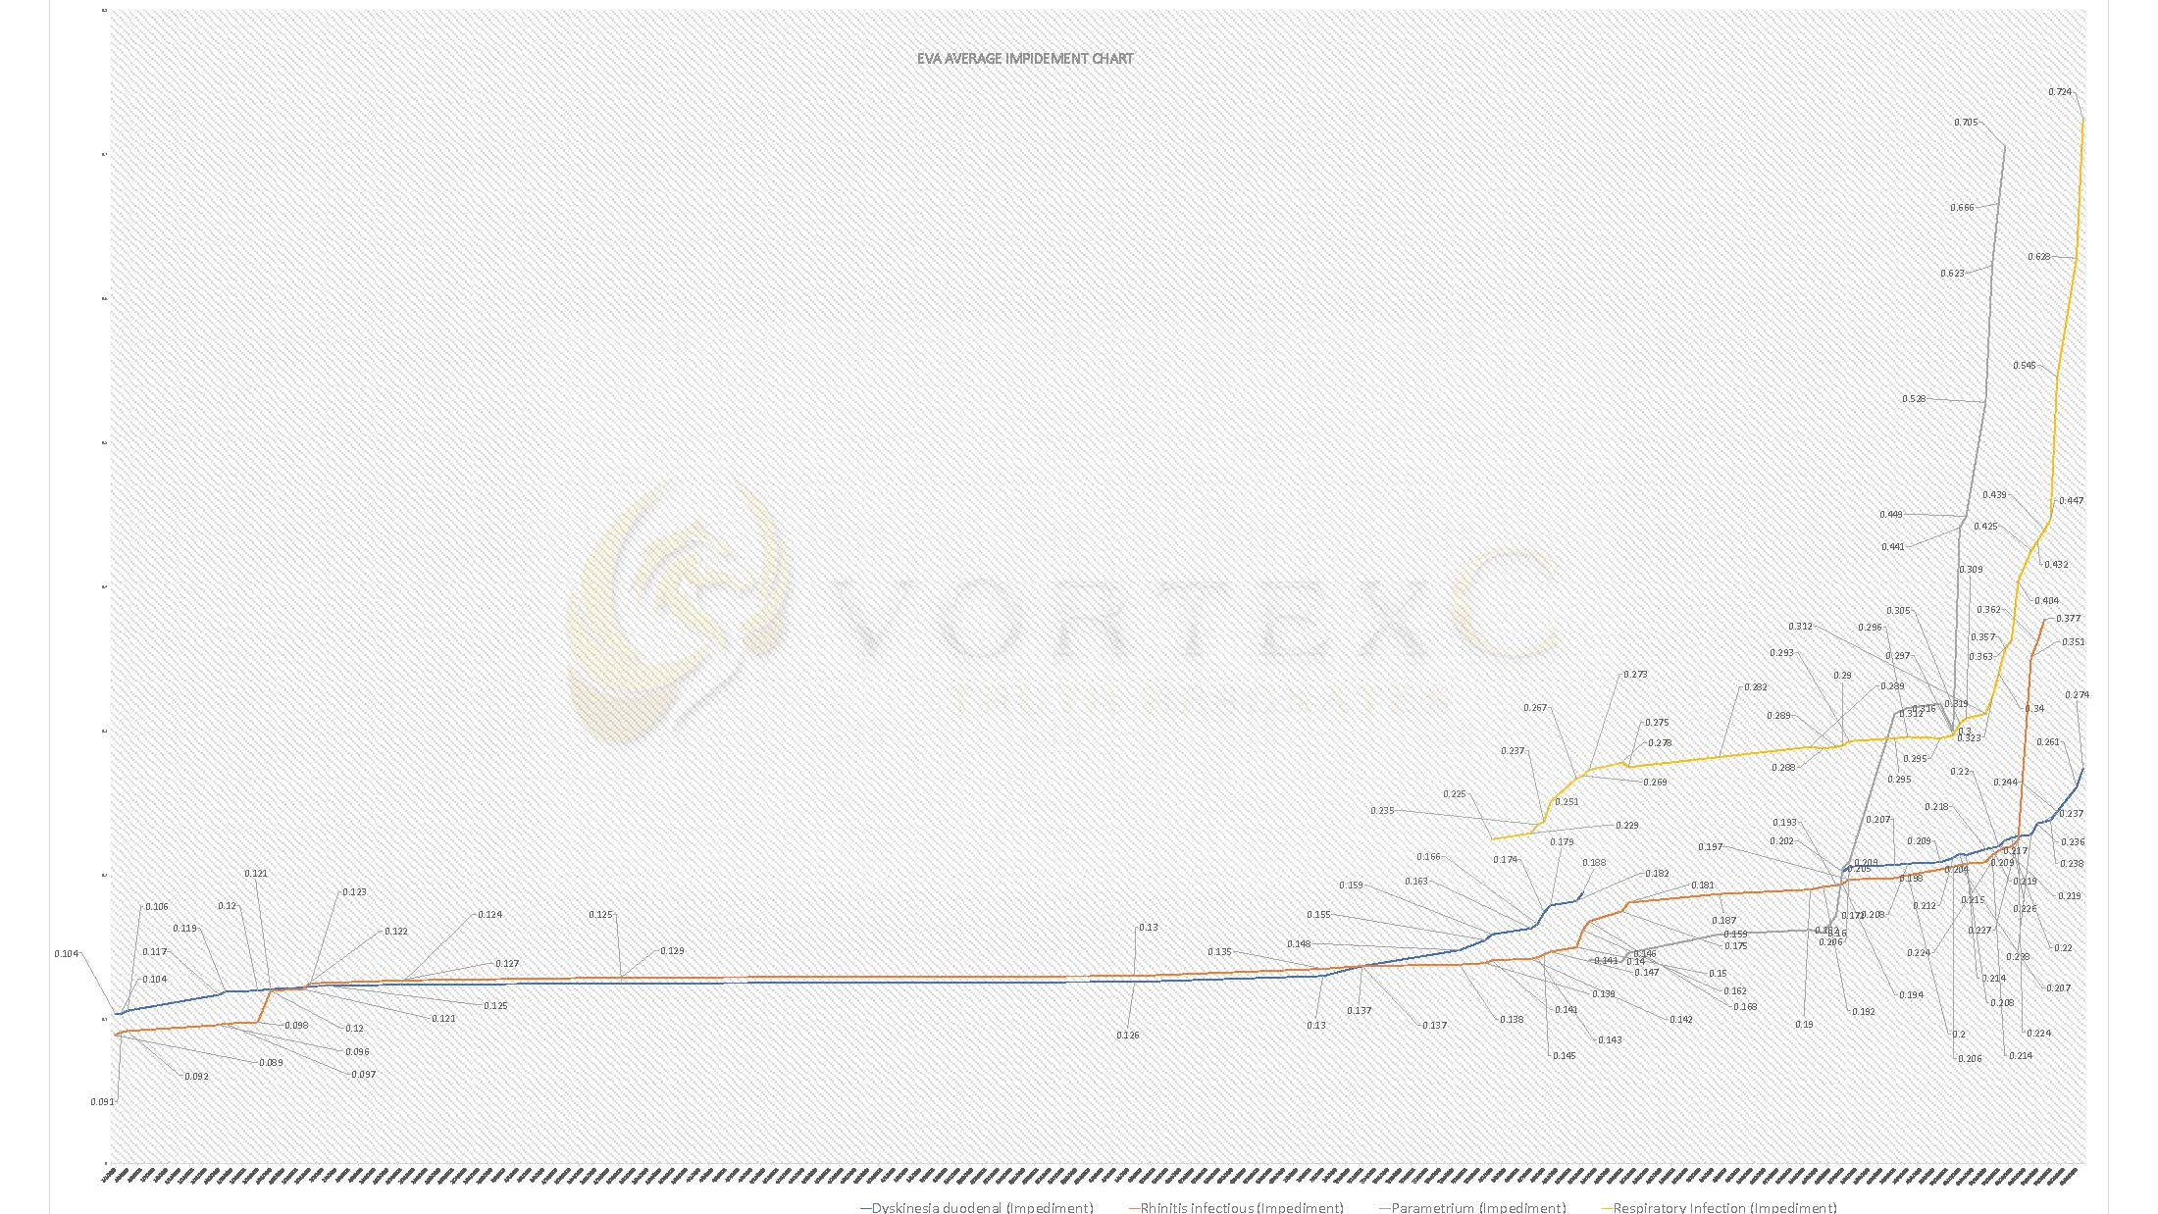

Slide 18
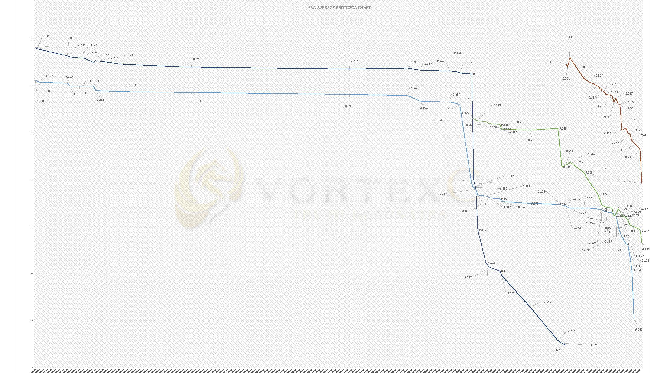

Slide 19
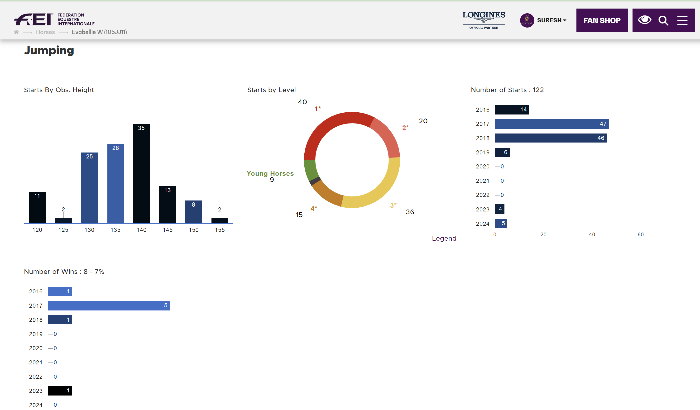
EVABELLIE W SIRE: COLMAN DAM: ANNABELLIE AGE: 15, SEX: MARE

Slide 20
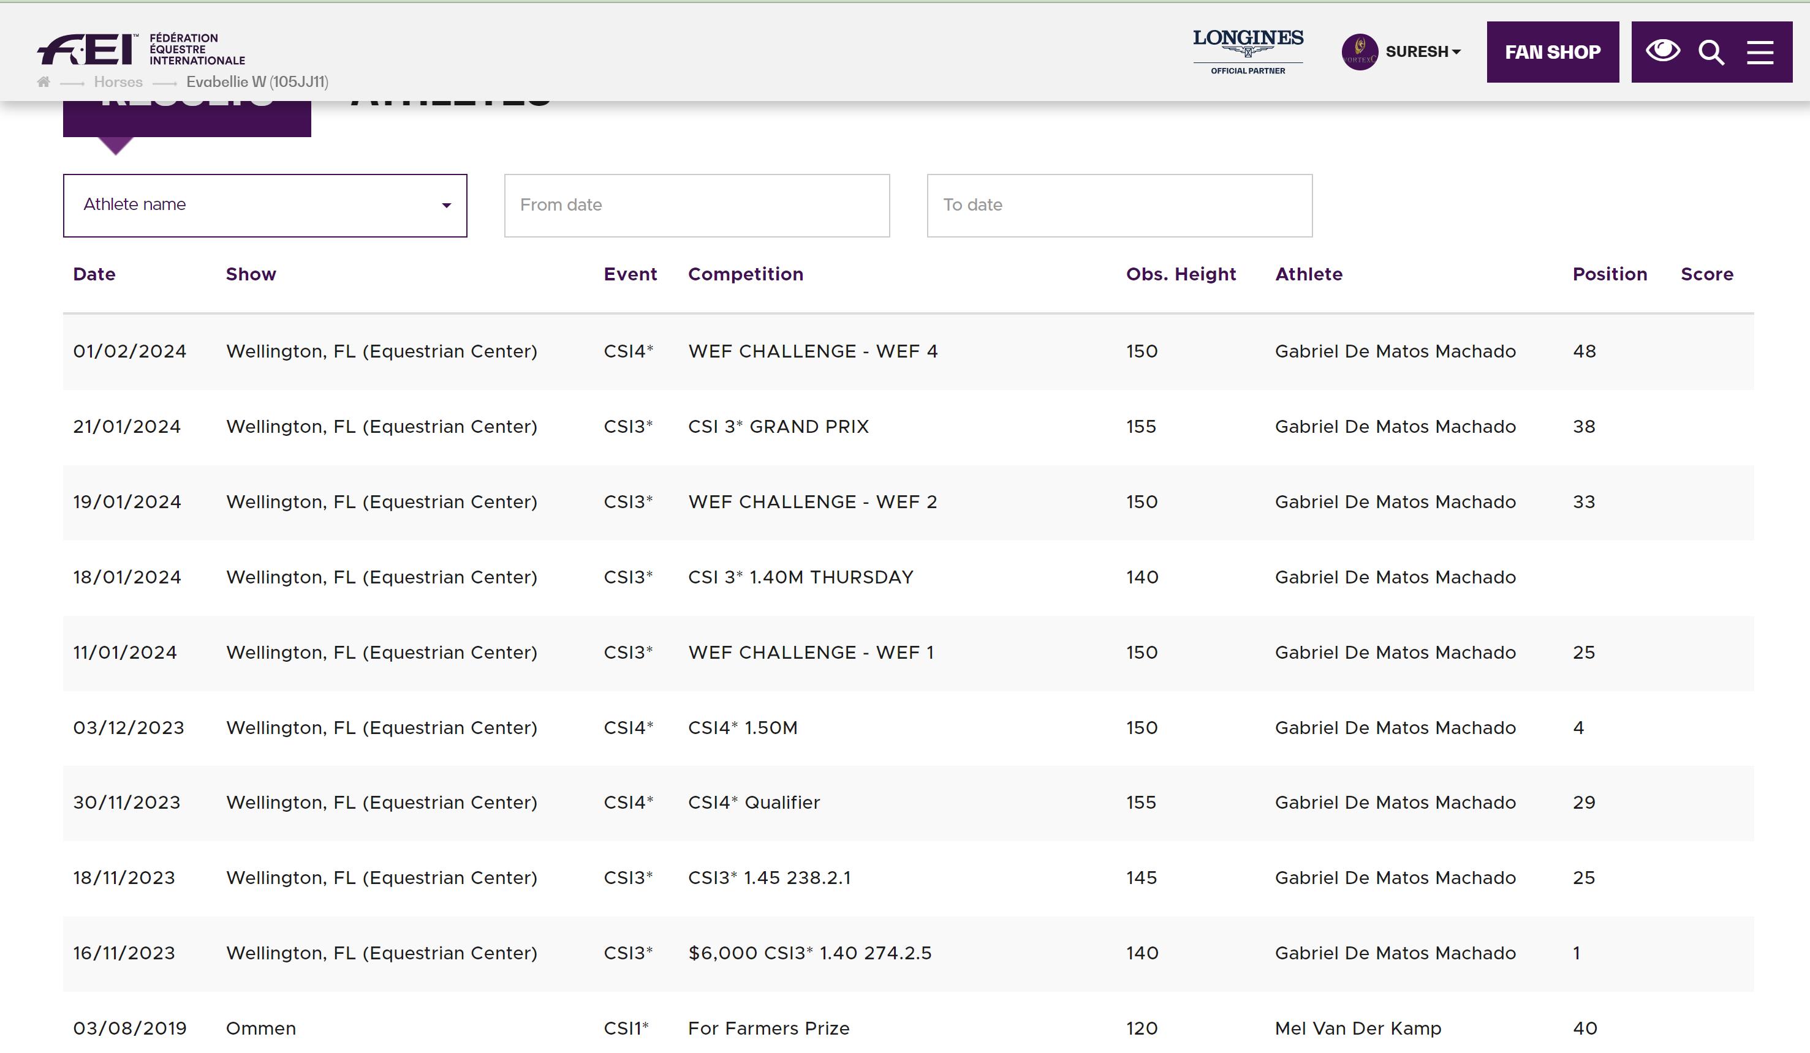
SIRE: COLMAN DAM: ANNABELLIE AGE: 15, SEX: MARE
EVA BELLIE W
RESULTS

Slide 21
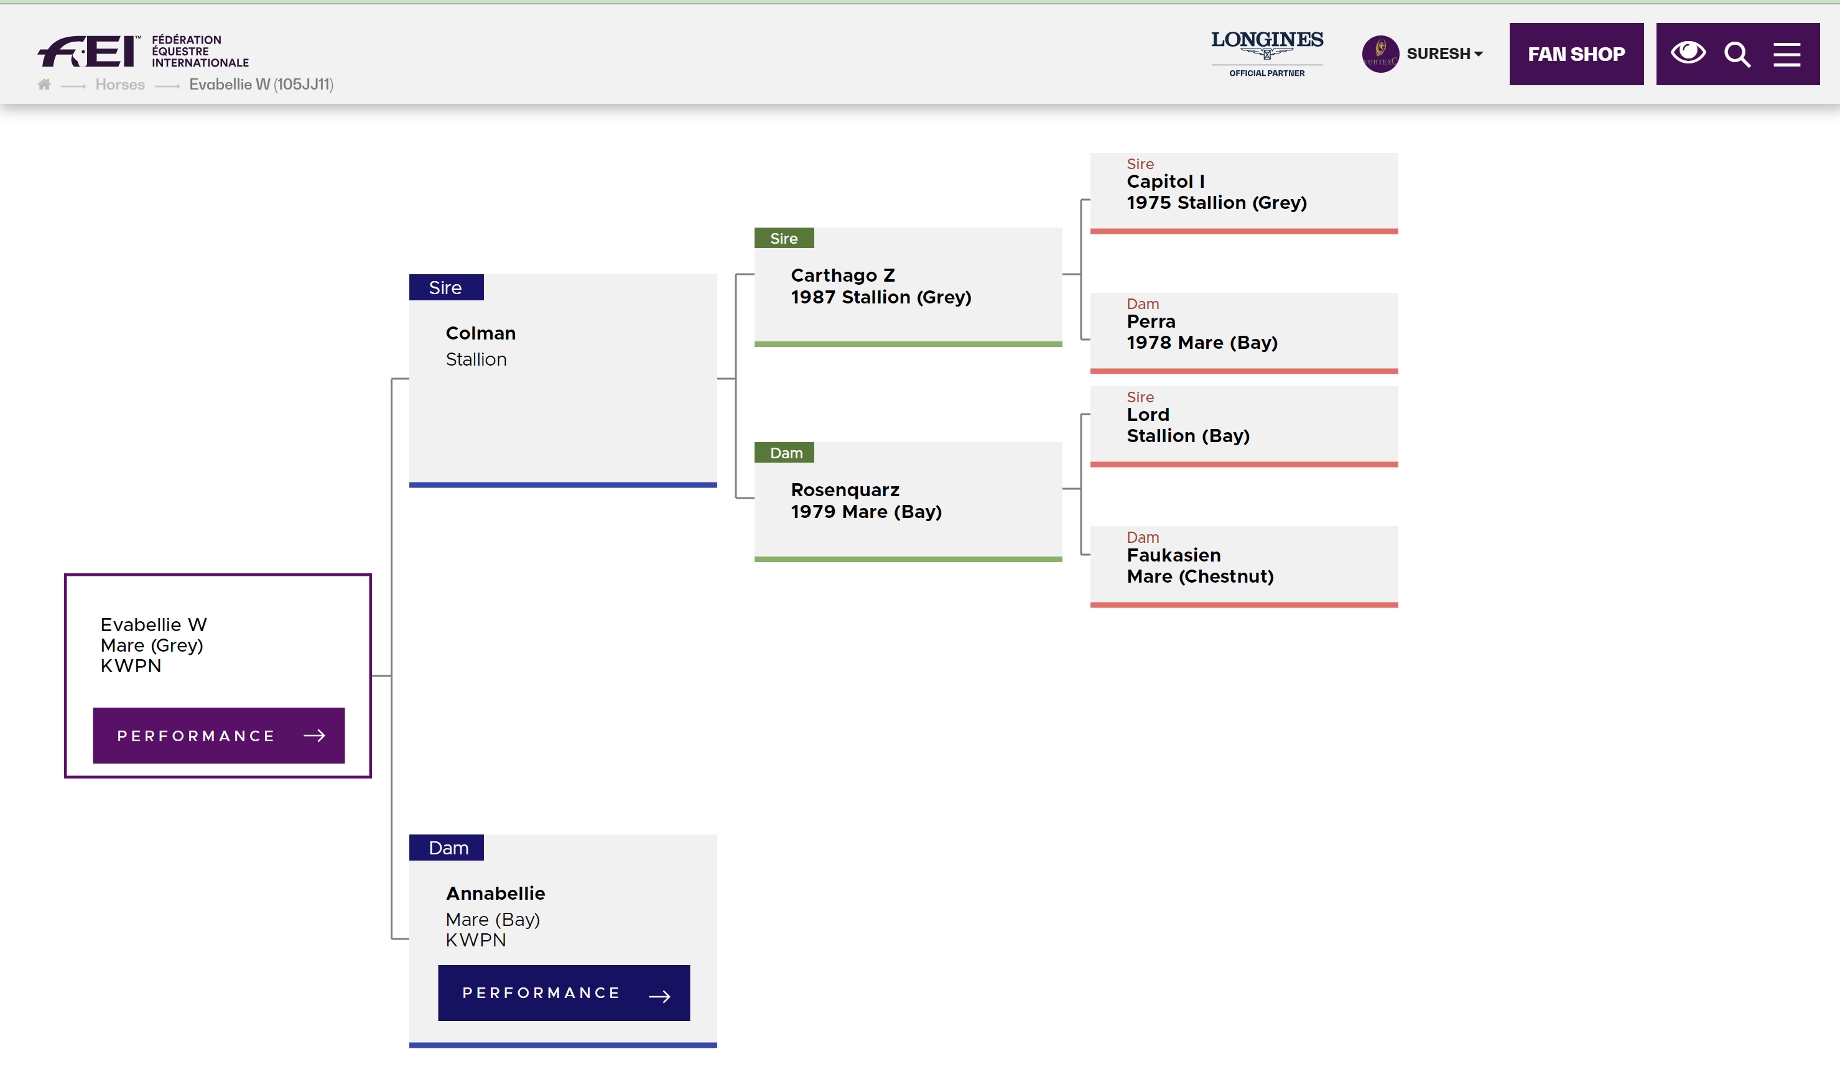
EVABELLIE W SIRE: COLMAN DAM: ANNABELLIE AGE: 15, SEX: MARE

Slide 22
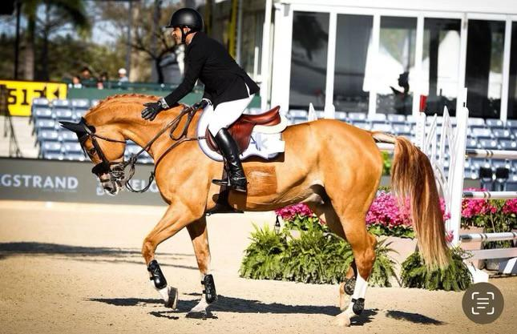
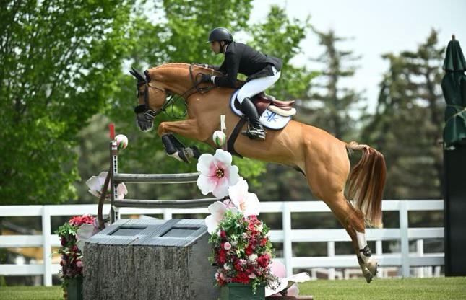
LEGALAND SANDRO SIRE: SANDRO BOY DAM: DRUMILLER DIGITAL SIRE OF DAM: CLINTON AGE: 10, SEX: GELDING
BACKGROUND:
ENROLLED IN VORTEXC PROGRAM SEPT 2023.
YOUNG WITH POTENTIAL (9 Y/O)
DEVELOPMENT PROJECT
PROGRESS:
FEI 3*- 6* EVENTS WITHIN 5 MONTHS
PERFORMANCE:
FULL PARTICIPATION IN ALL EIGHT 2024 5* WEF EVENTS
OLYMPIC QUALIFIER
2024 MAJOR LEAGUE SHOW JUMPING SERIES
2025 WEF

Slide 23
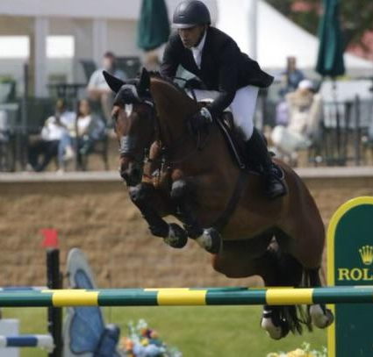
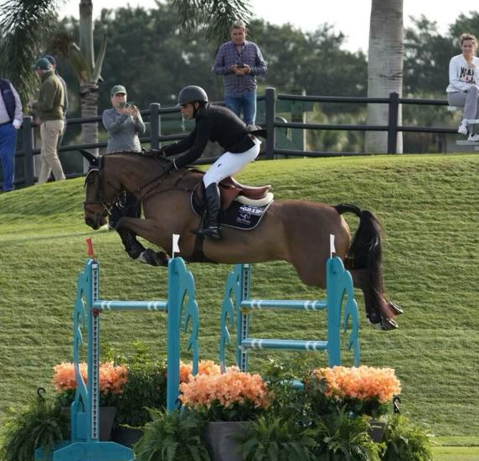
DONNER SIRE: THUNDER VD ZUUTHOEVE DAM: BURMESE SIRE OF DAM: HEARTBREAKER AGE: 14, SEX: GELDING
BACKGROUND:
JANUARY 2024 ACQUISITION
EXCELLENT VALUE
HIGHEST POTENTIAL
PROGRESS:
FEI 3* TO FEI 6* WITHIN 6 MONTHS
PERFORMANCE:
ACTIVE IN 2024 WEF SEASON
PODIUM FINISH 2024 SPRUCE MEADOWS
FUTURE:
OLYMPIC QUALIFIER
2024 MLSJ SERIES
2025 WEF

Slide 24
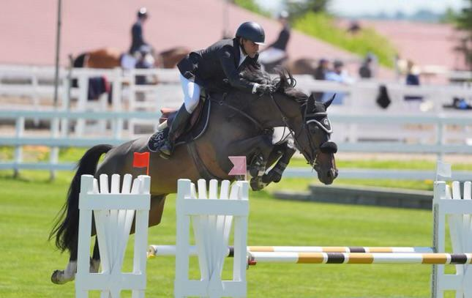
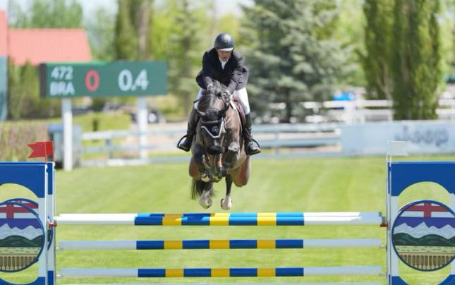
QOURTOIS SIRE: NABAB DE REVE DAM: UPHDIM VAN DE PUITVOET SIRE OF DAM: HEARTBREAKER AGE: 08, SEX: GELDING
BACKGROUND:
VALUE ACQUISITION – APRIL 2024
HIGH POTENTIAL
YOUNG (8 Y/O)
DEVELOPMENT PROJECT (~1.5YR USUALLY)
PROGRESS:
QUALIFIED FOR 6* FEI WITHIN 3 MONTHS
FUTURE:
2024 MLSJ SERIES
2025 WEF SEASON

Slide 25
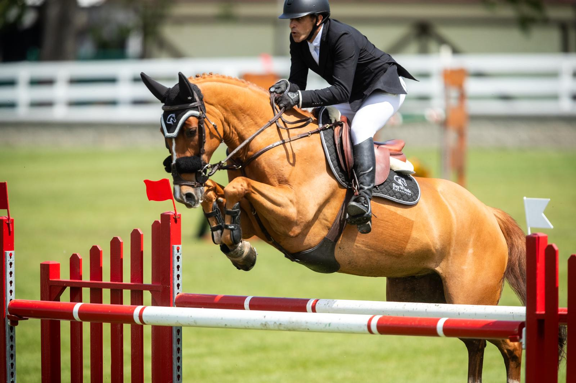
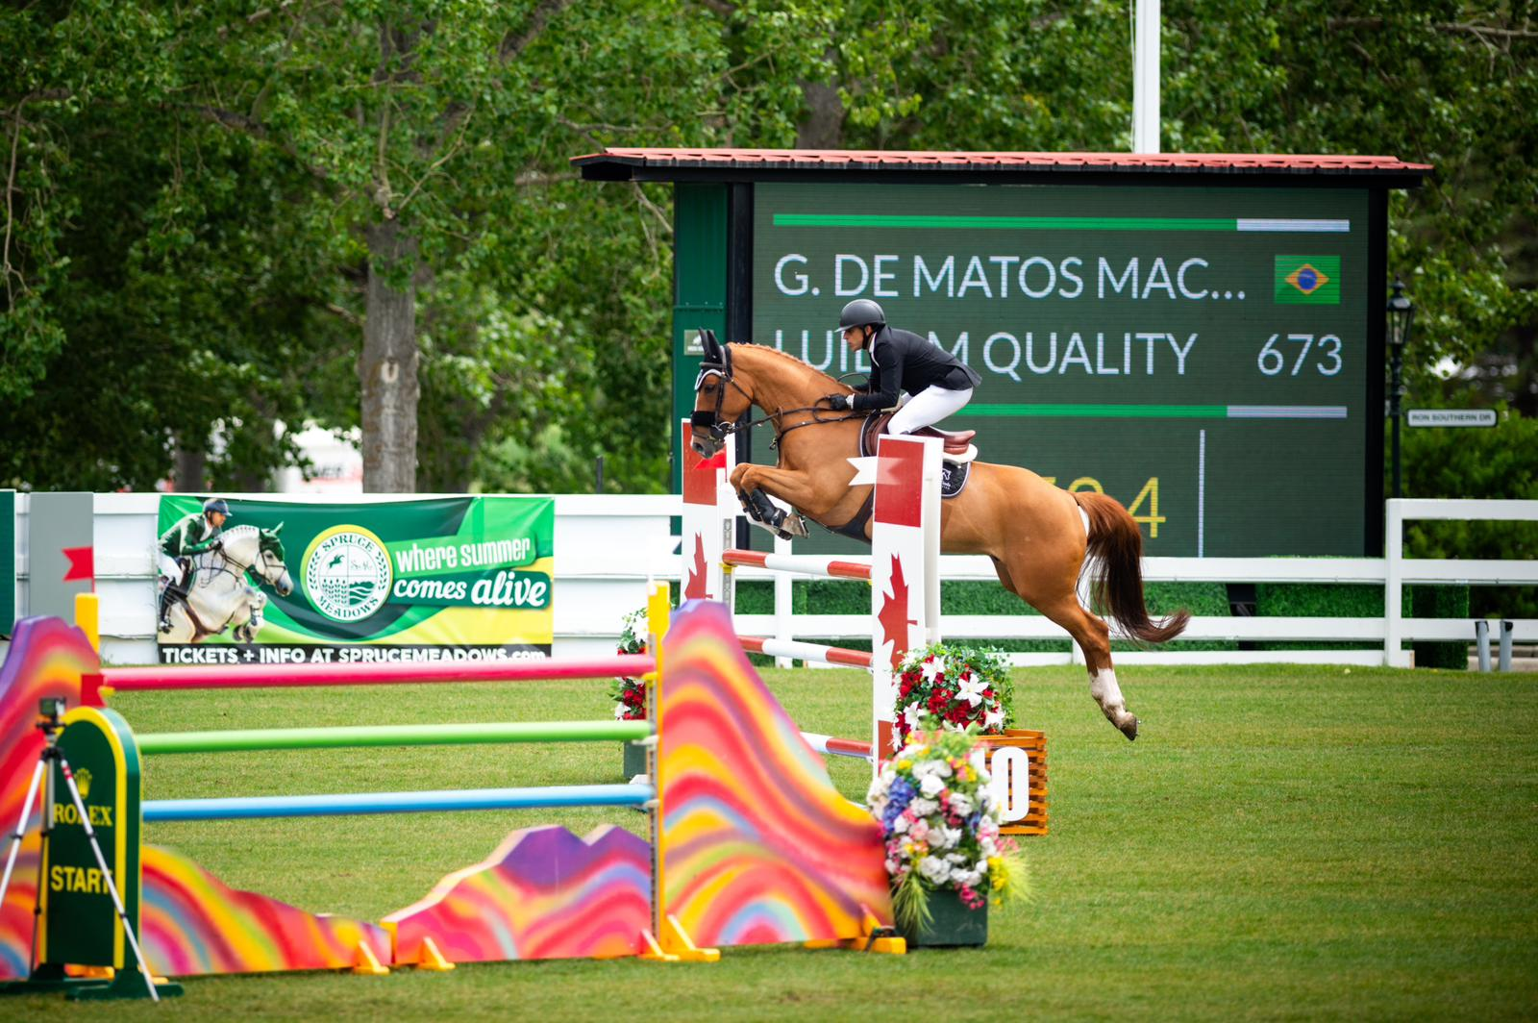
LUIDAM QUALITY SIRE: LUIDAM DAM: QUALITYKEE SIRE OF DAM: OBOS QUALITY 004 AGE: 09, SEX: GELDING
BACKGROUND:
YOUNG HORSE (9 Y/O)
INTESTINAL STONE
PAINFUL CONDITION
WORSENING
RECOVERY:
VORTEXC PROGRAM
STONE WAS MITIGATED NONINVASIVELY
QUICK RETURN TO HEALTHY STATE
CURRENT STATUS
SUMMER TRAINING IN CANADA
2024 MAJOR LEAGUE SHOW JUMPING SERIES
2025 WEF

Slide 26
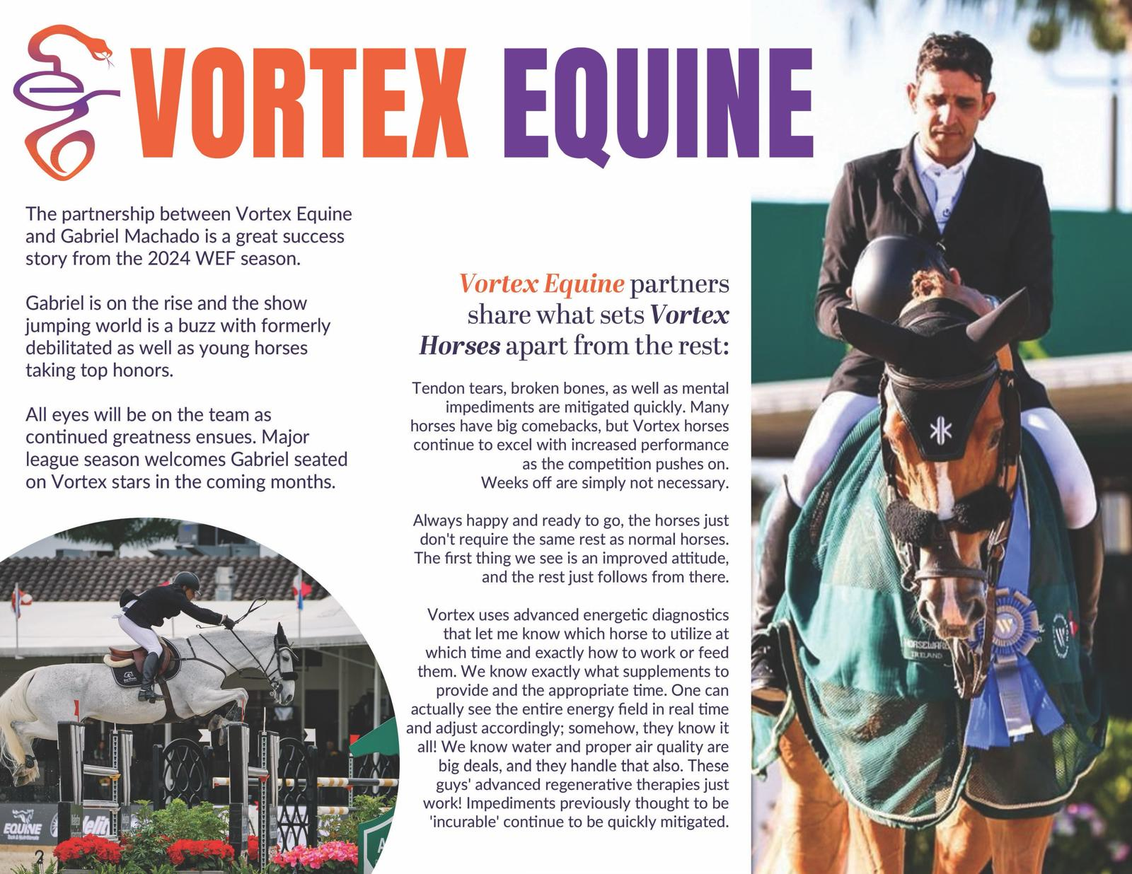
Gabriel De Matos Machado Longines Ranking: 619th
Age: 39
Competing for: Brazil - BRA

Slide 27
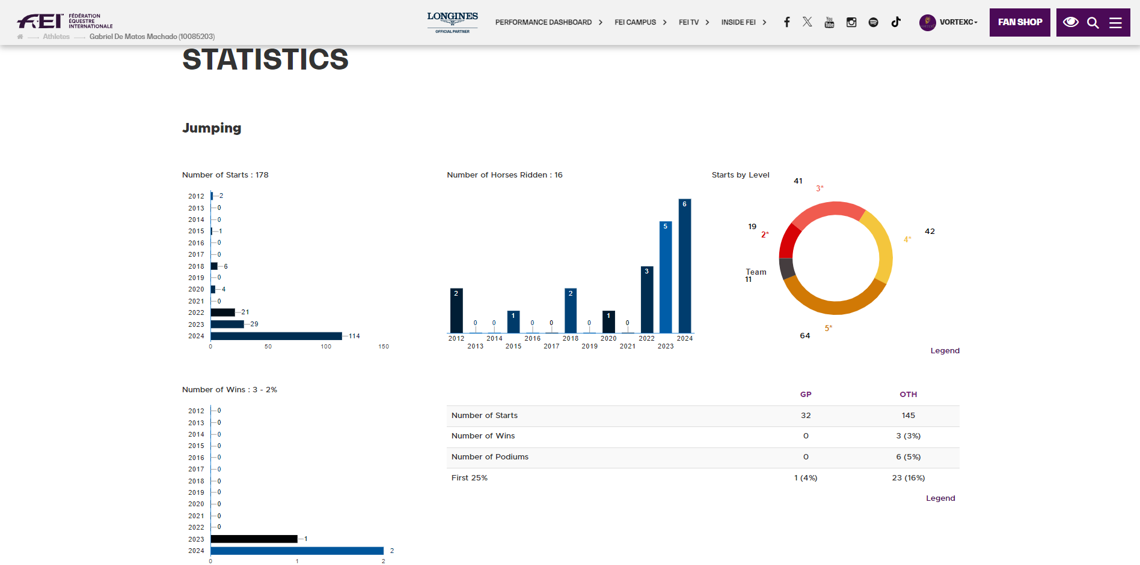
Gabriel De Matos Machado Longines Ranking: 619th
Age: 39
Competing for: Brazil - BRA

Slide 28
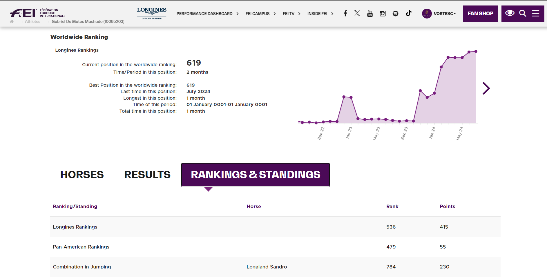
Gabriel De Matos Machado Longines Ranking: 619th
Age: 39
Competing for: Brazil - BRA

Slide 29
The Team
Erik Leander: Partner at VortexC, Erik is responsible for strategic partnerships, technology and program development. His innovations have set new standards in the equestrian industry.
Dr. Suresh Raja: Partner at VortexC, Dr. Raja is a pioneer in mitochondrial health, combining regenerative expertise with cutting-edge research to optimize horse performance and longevity. His role in data collection ensures the integration of the latest scientific advancements
Gabriel De Matos Machado: A renowned rider and trainer with extensive experience in training elite show jumpers. Gabriel’s expertise and success in competitions make him a valuable asset to the VortexC Equine team.

Slide 30

Join Us!
Learn more about VortexC Equine’s edge in show horse development Click Here to Know More
Info@VortexC.com

